Slide 1
Network Environment Management
Discovering Neighbors on the Network

Slide 2
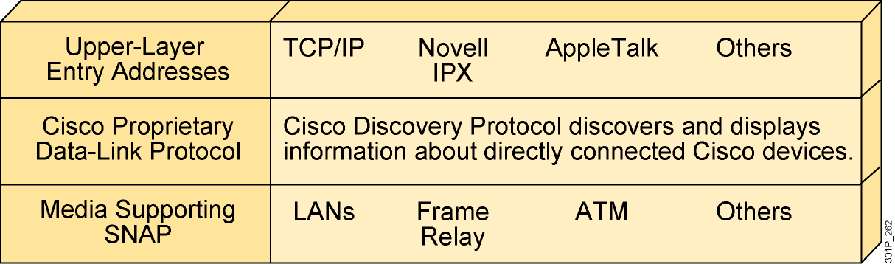
Cisco Discovery Protocol
  Cisco Discovery Protocol is a proprietary utility that provides a summary of directly connected switches, routers, and other Cisco devices.
  Cisco Discovery Protocol discovers neighboring devices, regardless of which protocol suite they are running.
  Physical media must support the SNAP encapsulation.
Notes:
Note: CDP is sent using multicast frames with the MAC address 0100.0ccc.cccc.

Slide 3
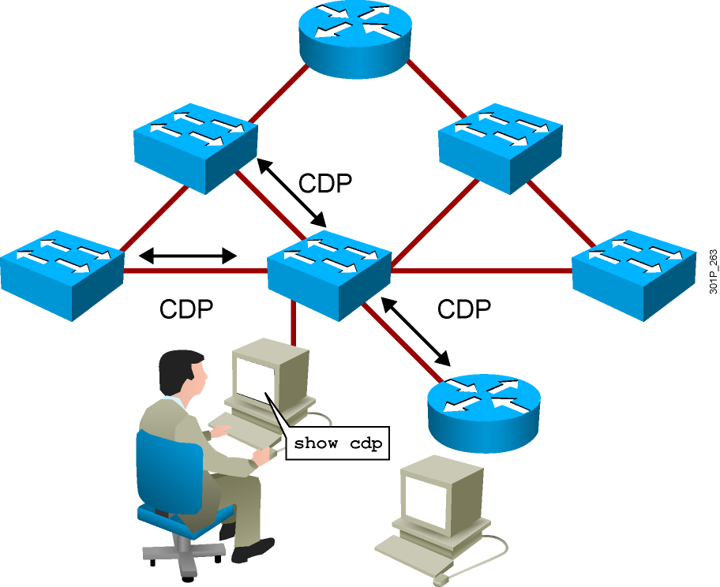
Discovering Neighbors with Cisco Discovery Protocol
  Cisco Discovery Protocol runs on Cisco IOS devices.
  Summary information includes:
    Device identifiers
    Address list
    Port identifier
    Capabilities list
    Platform
Notes:
Emphasize: CDP is media- and protocol-independent and runs on all Cisco-manufactured equipment including routers, access servers, switches, and some managed hubs. With CDP, network management applications can retrieve the device type and SNMP agent address of neighboring devices. This capability enables applications to send SNMP queries to neighboring devices.
CDP allows network management applications to dynamically discover Cisco devices that are neighbors. CDP runs on all media that support the Subnetwork Access Protocol, including LAN and Frame Relay. CDP runs over the data link layer only, not the network layer. Therefore, two systems that support different network-layer protocols can learn about each other.
Cached CDP information is available to network management applications. Cisco devices never forward a CDP packet. When new information is received, old information is discarded. The holdtime determines how long to keep existing information from a neighbor.

Slide 4
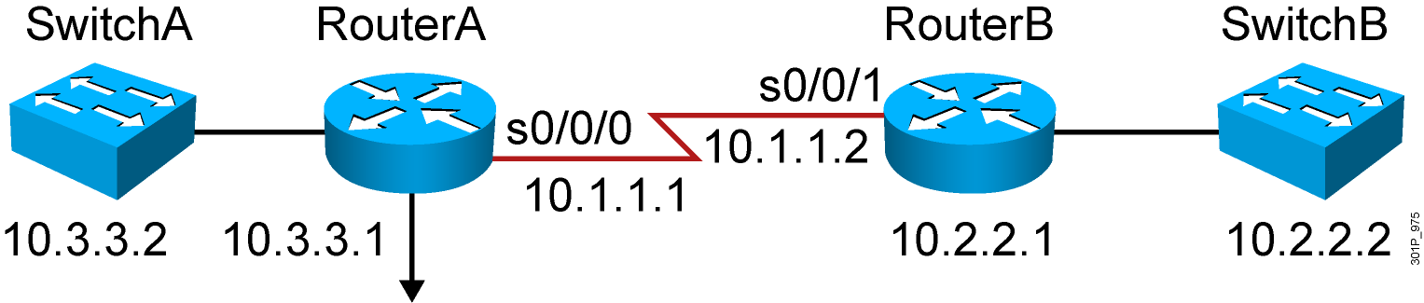
Using Cisco Discovery Protocol
RouterA#show cdp ?
entry Information for specific neighbor entry
interface CDP interface status and configuration
neighbors CDP neighbors entries
traffic CDP statistics
<cr>
RouterA(config)#no cdp run
RouterA(config)#interface serial0/0/0
RouterA(config-if)#no cdp enable
Notes:
Note: Some of the CDP commands are not available on the Catalyst 1900 switch, like cdp run, show cdp traffic, and show cdp entry.

Slide 5
Using Cisco Discovery Protocol
RouterA#show cdp ?
entry Information for specific neighbor entry
interface CDP interface status and configuration
neighbors CDP neighbor entries
traffic CDP statistics
…
RouterA(config)#no cdp run
! Disable CDP Globally
RouterA(config)#interface serial0/0/0
RouterA(config-if)#no cdp enable
! Disable CDP on just this interface
Notes:
Note: Some of the CDP commands are not available on the Catalyst 1900 switch, like cdp run, show cdp traffic, and show cdp entry.

Slide 6
Using the show cdp neighbors Command
RouterA#show cdp neighbors
Capability Codes: R - Router, T - Trans Bridge, B - Source Route Bridge
S - Switch, H - Host, I - IGMP, r - Repeater
Device ID Local Intrfce Holdtme Capability Platform Port ID
SwitchA fa0/0 122 S I WS-C2960- fa0/2
RouterB s0/0/0 177 R S I 2811 s0/0/1
Notes:
Emphasize: This graphic shows the show cdp neighbors command initiated from a router, which displays a summary of the capabilities and access details for the CDP neighbors. The show cdp neighbors detail command shows detailed information about the same devices.
Note: If the neighbor is a Catalyst 1900 switch, the switch MAC address is also displayed. If the switch is a 2900xl, its MAC address is not displayed.

Slide 7
Using the show cdp entry Command
Device ID: RouterB
Entry address(es):
IP address: 10.1.1.2
Platform: Cisco 2811, Capabilities: Router Switch IGMP
Interface: Serial0/0/0, Port ID (outgoing port): Serial0/0/1
Holdtime : 155 sec
Version :
Cisco IOS Software, 2800 Software (C2800NM-ADVIPSERVICESK9-M), Version 12.4(12), RELEASE SOFTWARE (fc1)
Technical Support: http://www.cisco.com/techsupport
Copyright (c) 1986-2006 by Cisco Systems, Inc.
Compiled Fri 17-Nov-06 12:02 by prod_rel_team
Notes:
Emphasize: The example shows what information can be obtained about RouterA’s neighbor. CDP is one way to learn about other Cisco devices on the network.

Slide 8
Additional Cisco Discovery Protocol Commands
RouterA#show cdp traffic
CDP counters :
Total packets output: 8680, Input: 8678
Hdr syntax: 0, Chksum error: 0, Encaps failed: 5
No memory: 0, Invalid packet: 0, Fragmented: 0
CDP version 1 advertisements output: 0, Input: 0
CDP version 2 advertisements output: 8680, Input: 8678
RouterA#show cdp interface s0/0/0
Serial0/0/0 is up, line protocol is up
Encapsulation PPP
Sending CDP packets every 60 seconds
Holdtime is 180 seconds
Notes:
Note: The holdtime indicates how long the neighbor information will be kept in the local CDP table.

Slide 9
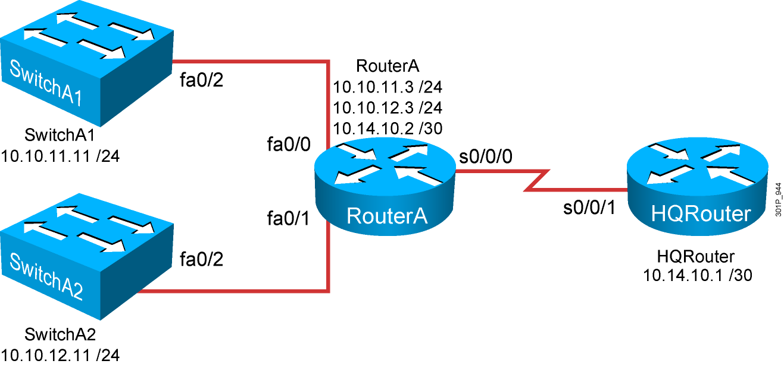
Creating a Network Map

Slide 10
Summary
  Cisco Discovery Protocol is an information-gathering tool used by network administrators to obtain information about directly connected devices.
  Cisco Discovery Protocol exchanges hardware and software device information with its directly connected Cisco Discovery Protocol neighbors.
  Cisco Discovery Protocol on a router can be enabled or disabled as a whole or on a port-by-port basis.
  The show cdp neighbors command displays information about the Cisco Discovery Protocol neighbors of a router.
  The show cdp entry, show cdp traffic, and show cdp interface commands display detailed Cisco Discovery Protocol information on a Cisco device.
  Using the information obtained from the show cdp command output, a network topology map can be created to aid troubleshooting.
Notes:
Purpose: This slide discuss the initial configurations on the routers and switches.
Note: There is no setup mode on the Catalyst 1900 switch.

